Slide 1
Mutah -VTC
Prof Omer Maaitah

Slide 2
Prof Omer Maaitah Mutah University

Slide 3
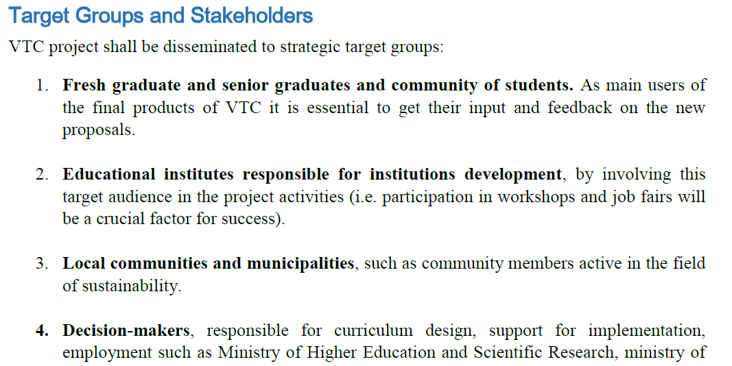

Slide 4
