Slide 1


Mutah –VTC
Achievements
15-10-2015 to
1-8-2018
Prof Omer Maaitah

Slide 2
Communication with all partner
Attending the Kickoff meeting
Establishing VTC center
Contributing in all training at EU
Many training courses conducted at Mutah from EU
Many training courses conducted at Mutah from Jo partners
Enhance the vocational concept at Mutah
Many workshops at Mutah

Slide 3
The web is establiseh
https://www.mutah.edu.jo/projects/vtc-mutah/work.htm
Many training courses developed at MU

Slide 4
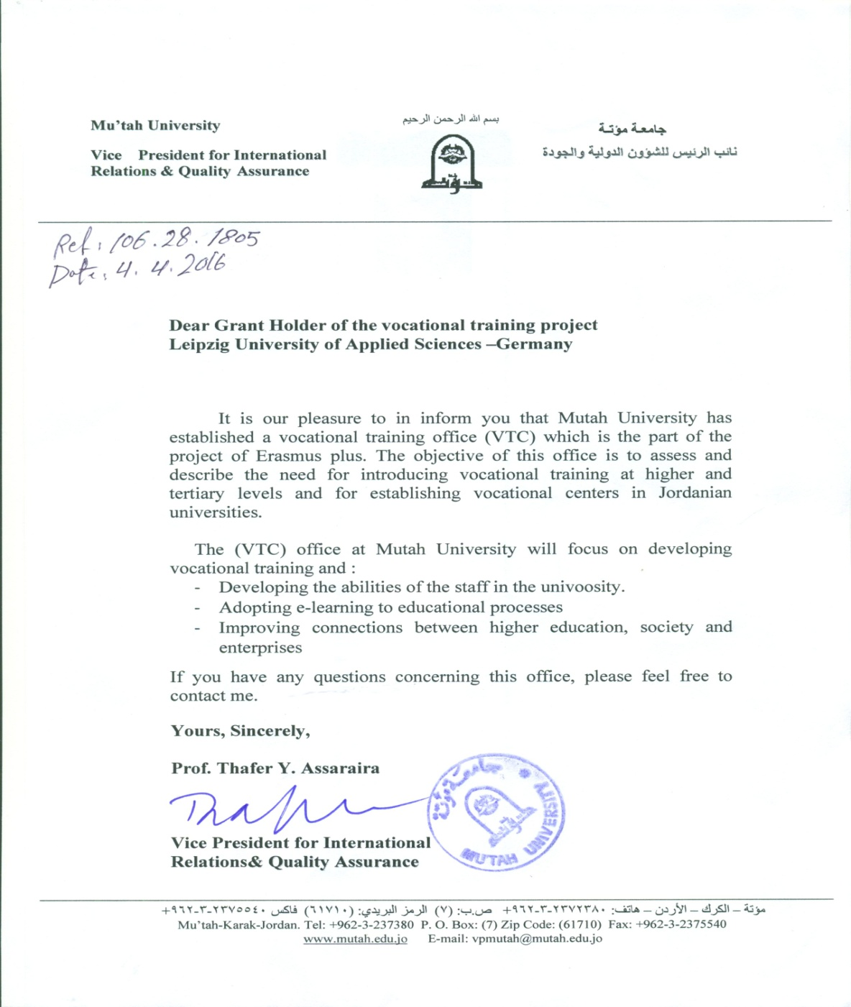

Slide 5
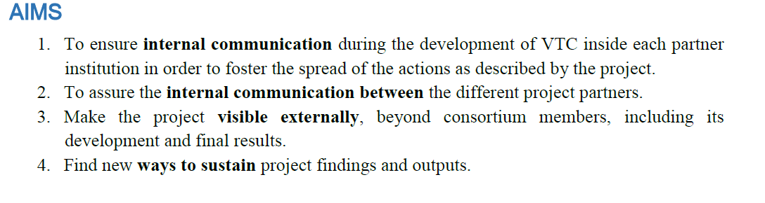

Slide 6
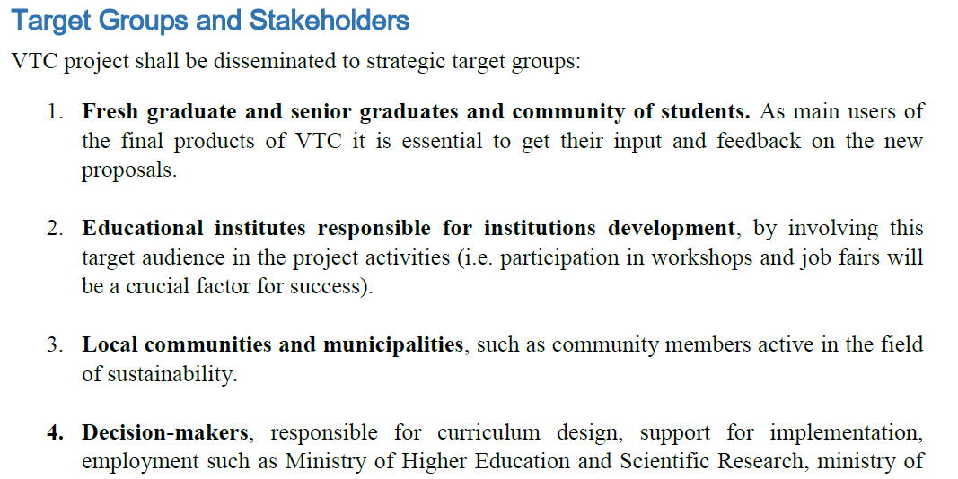

Slide 7
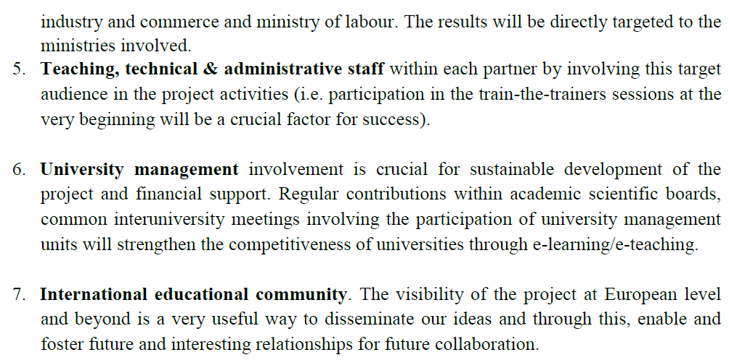

Slide 8
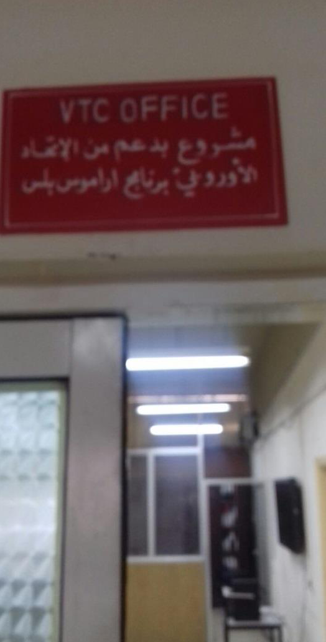

Slide 9
Training title (conducted at MU) attendance: Student and Staff
1-WORKSHOP on Vocational Training for Undergraduate University Students and Teachers in Jordan (VTC)
(Role of MUTAH VTC)
Date: 28 – 30 November 2016
Place: Faculty of Engineering, Mutah University Karak –Jordan
2- Developing the Reflective Thinking and Problem Solving
Prepared and Implemented by: Dr. Bassam Abdullah Taha
Date August 1, 2017
3- Global citizenship education - Critical Thinking in Solving Problems and New Ideas
By Dr. Mravcová Anna
Date 22-10-2017
4- Skills in Using Computer Software - Neuromarketing as progressive methods in market research
By Dr. Berčík Jakub
Date 22-10-2017

Slide 10
5- Sales and Marketing Skills - Contrast in International Marketing between Chosen European –Asian - African countries
Dr. Paluchová Johana
6- Basic Fundamentals in Project Management - Internationalization, Networking and Project Cooperation Opportunities in Higher Education
By Dr. Gálová Jana
7- Title: Sales and Marketing Skills: Strategy and tactics
Conducted by Dr. Joaquim Marques
Date: 13-11-2017
8- History, Heritage, and Development. The Touristic Activity
By Dr. Mário Cunha
9- Business Administration in the 21st century
By Dr. Maria de Nascimento | Dr. Mário Cunha | Dr. Joaquim Marques
10- Vocational Training Center for Undergraduate University Students and Teachers in Jordan (VTC)
Workshop : 2-3 September 2018

Slide 11
Developed​ training courses in MU
1-Highway Construction Stages
2-Road maintance.
3-TQM present gift to Trainers
4-Training Highway in classicification

Slide 12
5- Network Layer and IPv4
6- Data Link Layer.
7- Introduction to Cisco IOS 15
8- Introduction to Cisco Routers and Operating Systems.
9- Introduction to IOS CLI
10- ios basic configuration tasks
11- Introduction to Cisco IOS 15
12- Network Introduction.
13- Reference Models
14- Application Layer
15- Network Layer and IPv4

Slide 13
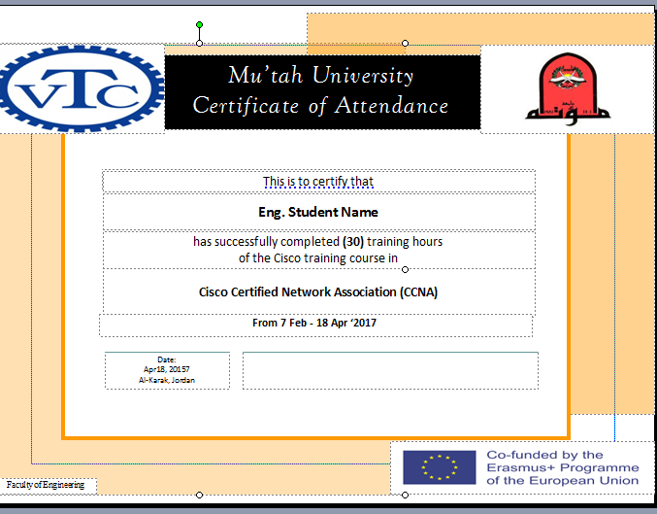

Slide 14
Dissemination
Social networks: A page for Facebook were created on Facebook with interesting and relevant information
Press dissemination: Press releases in different media was published for the project. Karak FM
Through the training and workshops
During the staff lectures

Slide 15
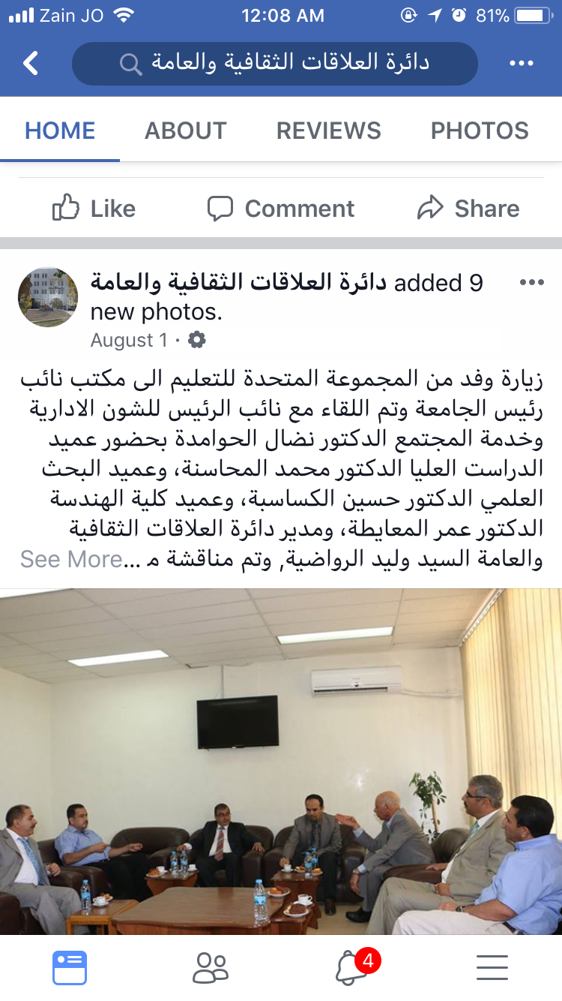

Slide 16
List of names contributing in the training at EU partners
Prof Thafer Asserea (president of University)
Omer Maaitah (contact Person)
Saif Nawaysieh (international Offic)
Mohamed Majalee (staff)
Khaled Shorafa (staff)
Mosa Magharbeh (staff)
Bassam Mahasenh (staff)
Mohamed Abdelwahab (staff)
Mohamed Sarairah (head of computer center)
Hani Zobi (head of computer engineering department)
Dr sameeh Sarayerh (Vic dean of faculty of medicine)

Slide 17
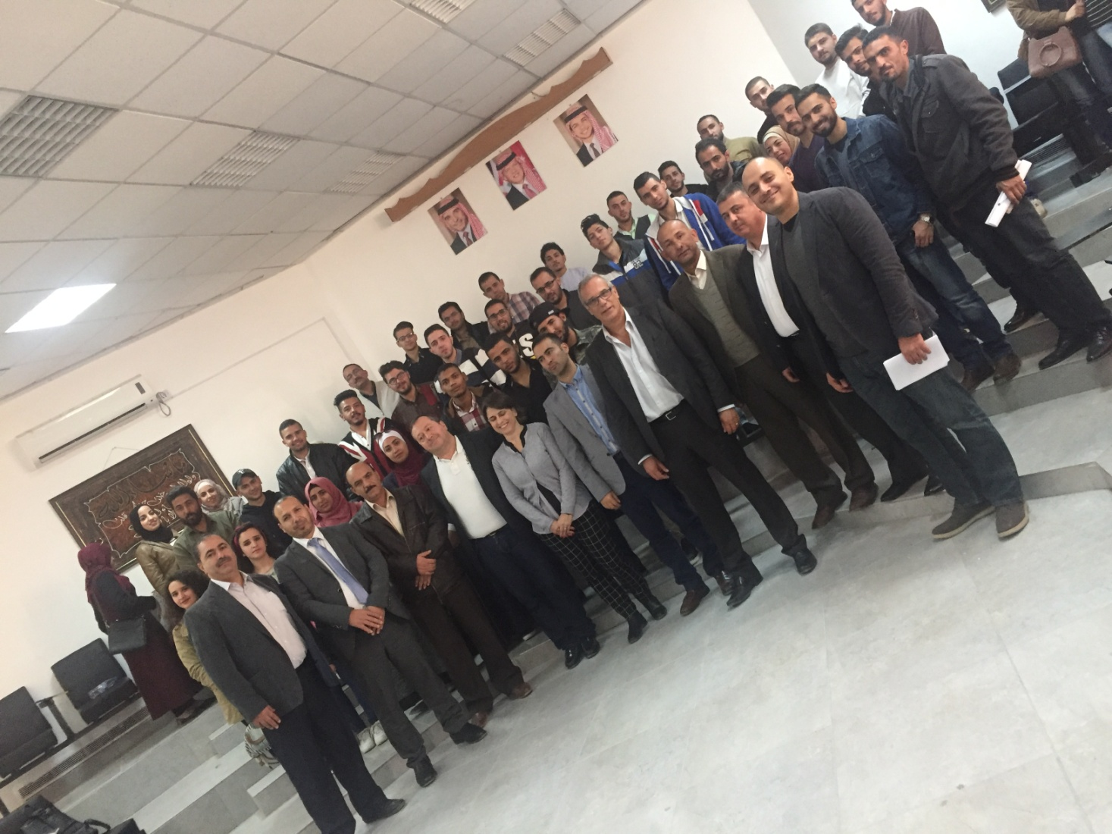

Slide 18
