Slide 1



Mutah –VTC
Achievements
15-10-2015 to
1-8-2018
Prof Omer Maaitah

Slide 2
Prof Omer Maaitah
Mutah University
Communication with all partner
Attending the Kickoff meeting
Establishing VTC center
Contributing in all training at EU
Many training courses conducted at Mutah from EU
Many training courses conducted at Mutah from Jo partners
Enhance the vocational concept at Mutah
Many workshops at Mutah

Slide 3
List of names contributing in the training at EU partners
Prof Thafer Asserea (president of University)
Omer Maaitah (contact Person)
Saif Nawaysieh
Mohamed Majalee
Khaled Shorafa
Mosa Magharbeh
Bassam Mahasenh
Mohamed Abdelwahab
Mohamed Sarairah
Hani Zobi

Slide 4
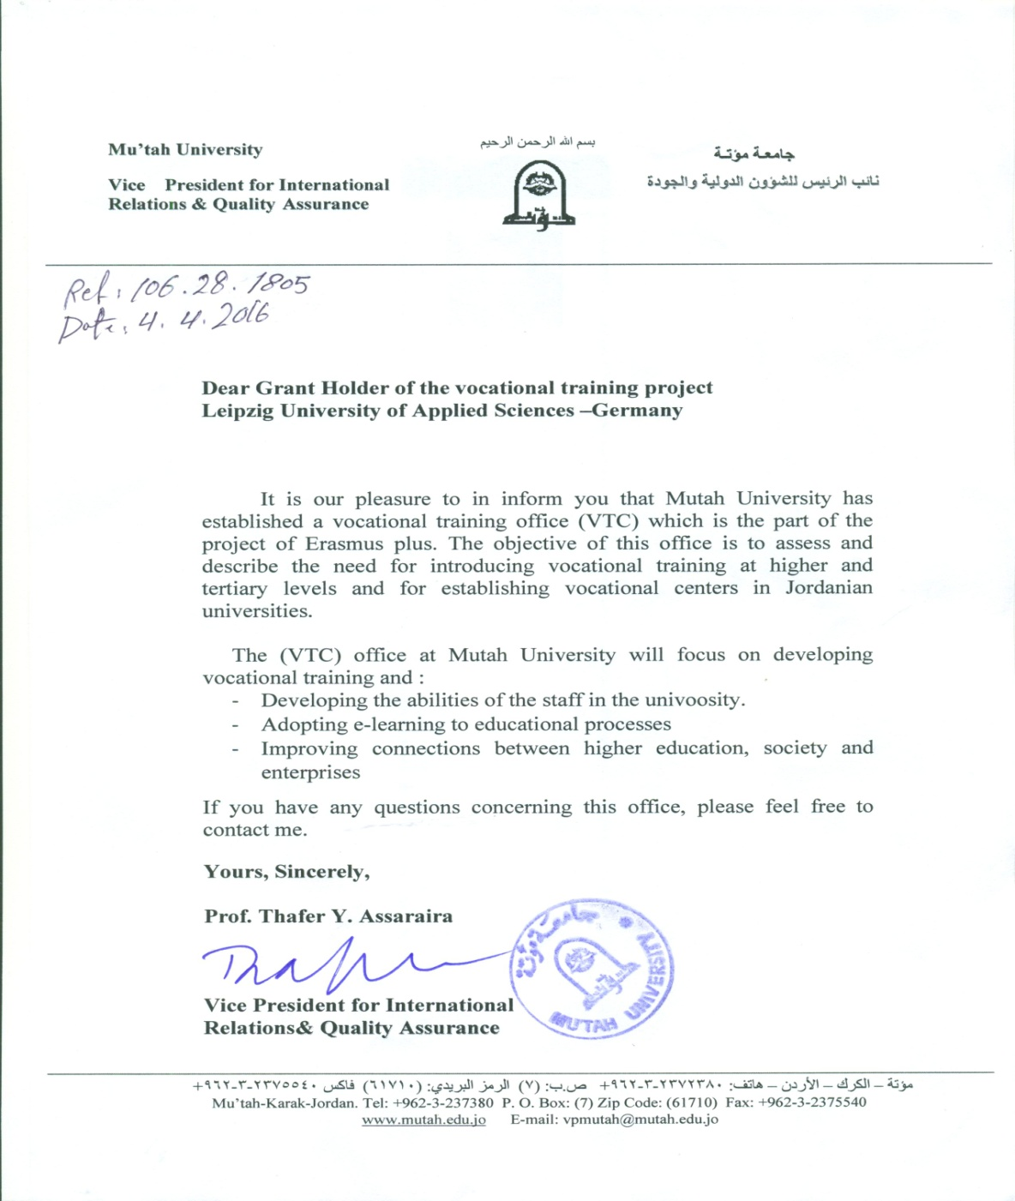

Slide 5
Training title
1-WORKSHOP on Vocational Training for Undergraduate University Students and Teachers in Jordan (VTC)
(Role of MUTAH VTC)
Date: 28 – 30 November 2016
Place: Faculty of Engineering, Mutah University Karak –Jordan
2- Developing the Reflective Thinking and Problem Solving
Prepared and Implemented by: Dr. Bassam Abdullah Taha
Date August 1, 2017
3- Global citizenship education - Critical Thinking in Solving Problems and New Ideas
By Dr. Mravcová Anna
Date 22-10-2017
4- Skills in Using Computer Software - Neuromarketing as progressive methods in market research
By Dr. Berčík Jakub
Date 22-10-2017

Slide 6
5- Sales and Marketing Skills - Contrast in International Marketing between Chosen European –Asian - African countries
Dr. Paluchová Johana
6- Basic Fundamentals in Project Management - Internationalization, Networking and Project Cooperation Opportunities in Higher Education
By Dr. Gálová Jana
7- Title: Sales and Marketing Skills: Strategy and tactics
Conducted by Dr. Joaquim Marques
Date: 13-11-2017
8- History, Heritage, and Development. The Touristic Activity
By Dr. Mário Cunha
9- Business Administration in the 21st century
By Dr. Maria de Nascimento | Dr. Mário Cunha | Dr. Joaquim Marques
10- Vocational Training Center for Undergraduate University Students and Teachers in Jordan (VTC)
Workshop : 2-3 September 2018

