Slide 1

Welcome to
Leipzig University of Applied Sciences
JOB-JO
Kick-Off Meeting 24.-26.02.2019
Dr.Riyadh Qashi
M.Sc. Alex Dekin

Slide 2
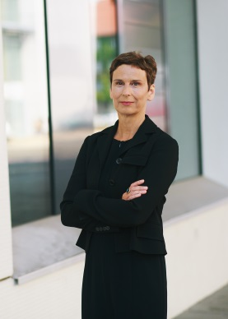
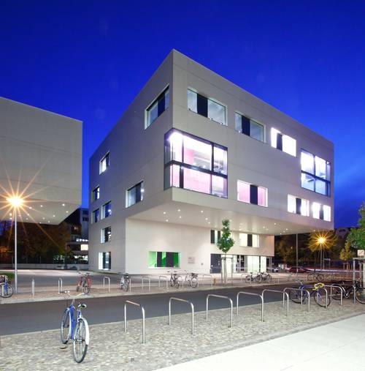
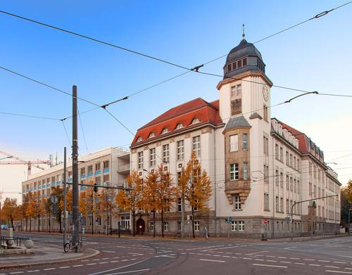

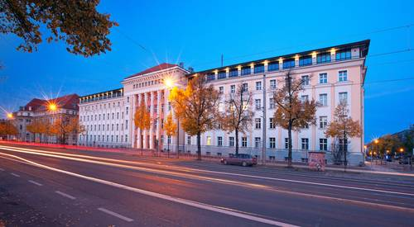
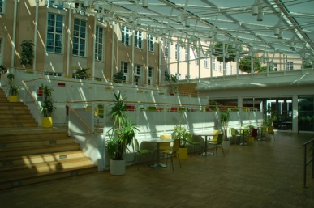
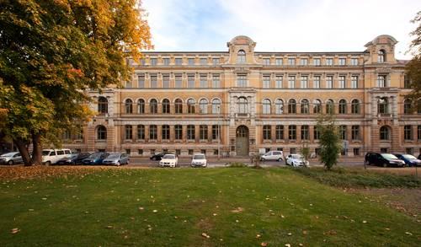
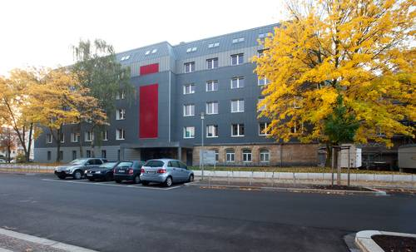
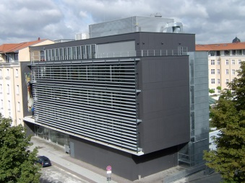
Our University
7 Faculties:
Architecture and Social Sciences
Business Administration
Civil Engineering
Computer Science, Mathematics and Natural Sciences
Electrical Engineering and Information Technology
Mechanical and Energy Engineering
Media
About 6000 students, 250 professors, 350 staff members
Chancellor
of the HTWK:
Prof.
Gesine
Grande

Slide 3
Our Faculty
Beneficial combination of Computer Science, Mathematics and
Natural Sciences
Professors by Knowledge field
Computer Science Mathematics
Physics Chemistry
Languages
15 8
3 1
1
Administrative, technical, computing and additional teaching staff: 30

Slide 4
Degree Programmes
6 degree programmes
Applied Mathematics (Bachelor)
7 terms, 3.5 years
Computer Science (Bachelor)
6 terms, 3 years
Media Informatics (Bachelor)
6 terms, 3 years
Applied Mathematics (Master)
3 terms, 1.5 years
Computer Science (Master)
4 terms, 2 years
Media Informatics (Master)
4 terms, 2 years
  Bachelor: base study: 1. - 3. semester, main study: 4. – 6 semester
  (practical semester: 5. semester, bachelor thesis: 6. semester)
At the moment: about 600 students at the Faculty

Slide 5
Projects
EU-Tempus and Erasmus+ Projects
EU-Tempus Projects
“eMeReCU”, “JointLab”, “Intercollegia”, “EU-TraceFer”, “EduViSim”,
“InterSCAN”, “itsofteam”, ”UnIvEnt”
EU-Erasmus+ Projects
2015: Co. “VTC”, “ModeHEd”, Partner. “INVENT”, “METHODS”, “LPEB”,
2016: Co. “OPATEL”, “MAGNET”, Partner. “BITPAL”, ”FoodQA”, ”LMPI”,
2017: Co. ”MediTec”

Slide 6
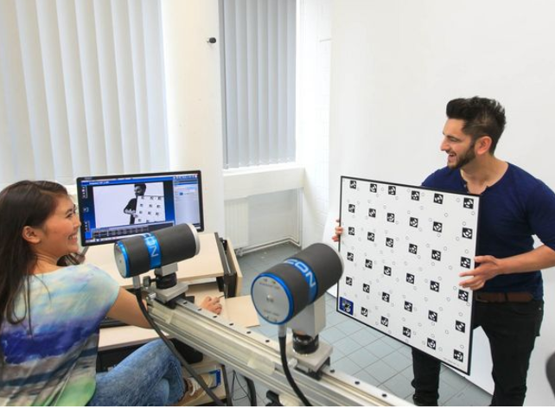
CAREER: Possibilities during and after graduation
The Staff of the Federal Employment Agency advises on the HTWK campus every Thursday on application, Job and career chances
The job portal publishes offers for final theses, internships, job offers, student jobs and student work positions
The Graduate Center of the HTWK Leipzig informs and advises on promotion-related questions

Slide 7
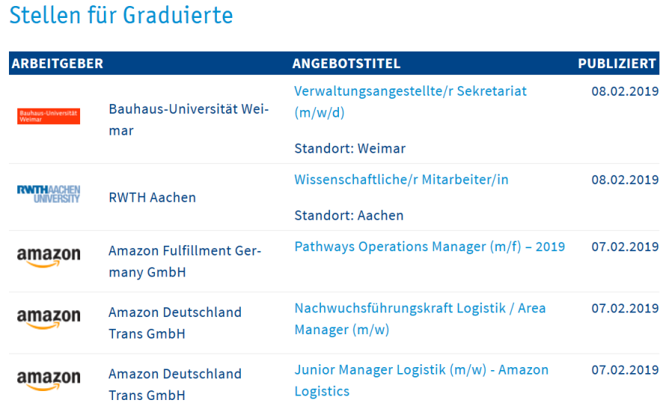
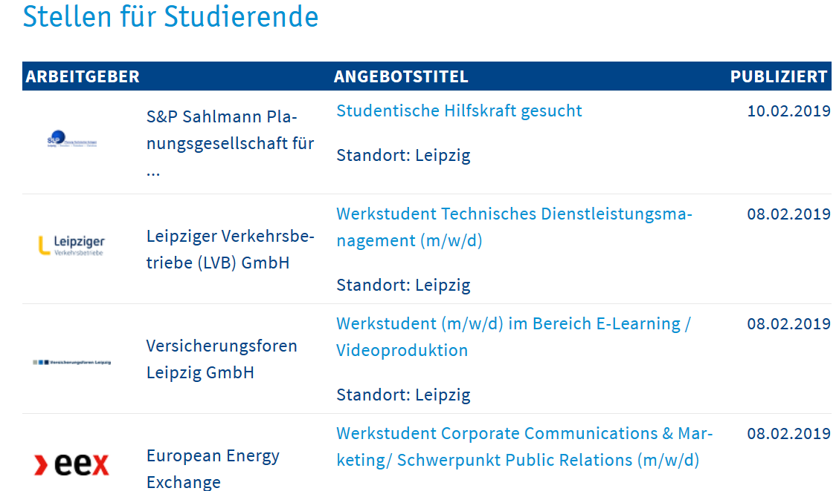
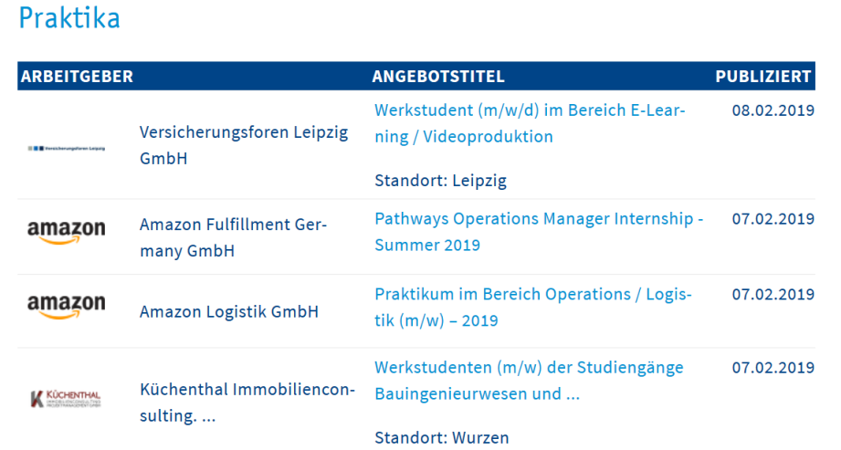
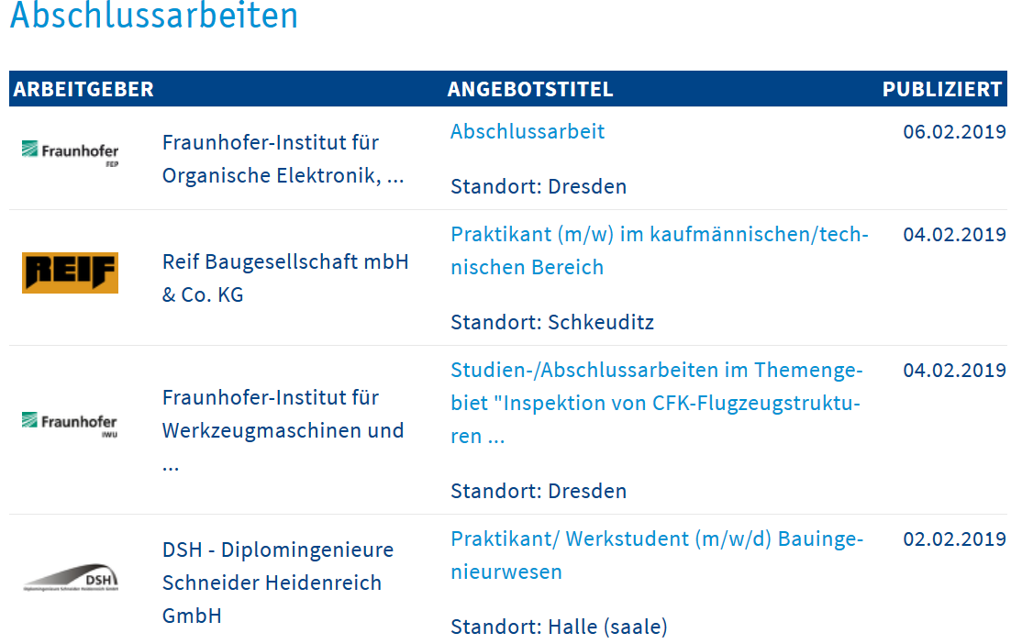

Slide 8


Studifit at HTWK
Application coaching and company contacts
Studifit: organises workshops and services available for job seekers
Get in touch with companies in your business Branch
Studifit offers workshops such as:
Job application and cover letter: How to Write a Job Application Letter and CV?
Individual application consultations
Studifit organizes an event "Companies for Guests": in order to get professionals from HEIs
Events on Start Ups: experiences, what you as an applicant and new employees need to start a business

Slide 9
Many Thanks for Your Attention

