Slide 1

The University of Jordan
Prof. Ahmed Al-Salaymeh
Promoting youth employment in remote areas in Jordan -(Job Jo)
598428-EPP-1-2018-1-JO-EPPKA2-CBHE-JP

Slide 2
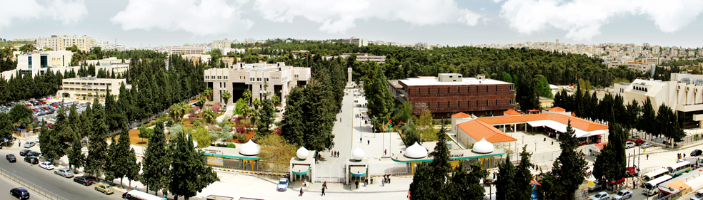
The University of Jordan (UJ)
www.ju.edu.jo

Slide 3
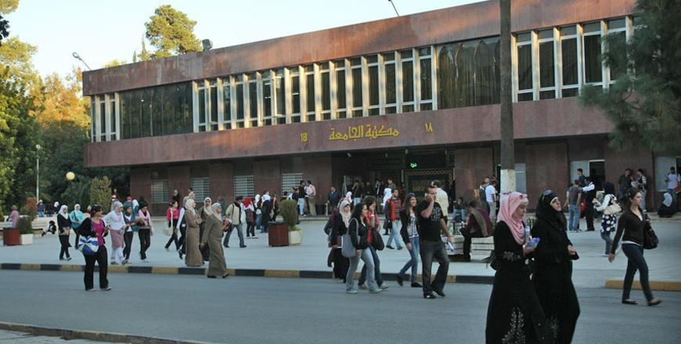





Facts
Established 1962
Since its foundation, the number of UJ graduates have exceeded 200,000 graduates around the world
UJ’s employment reputation is 330 worldwide according to QS World Universities Ranking of 2019
One of the best 650 Universities worldwide
One of the best 10 Arab universities
It has recently achieved 4 according to QS.

Slide 4
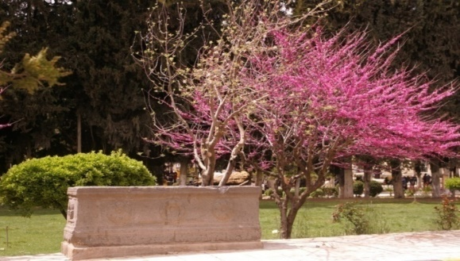
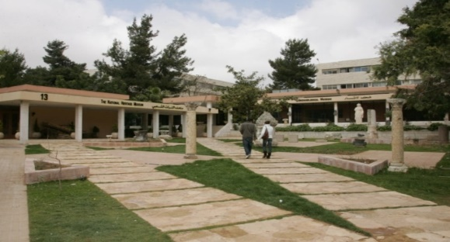
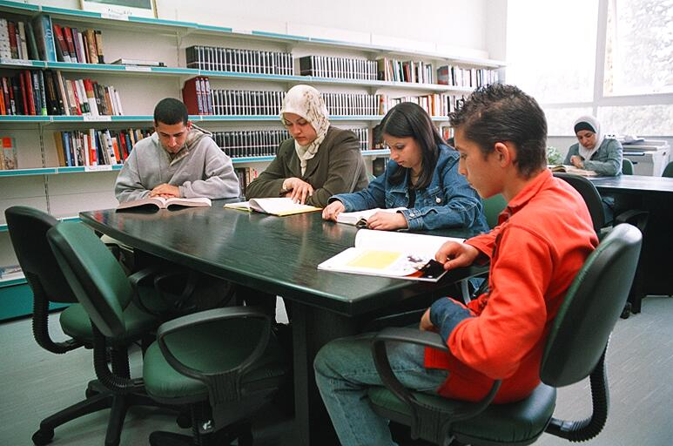
Degree Programs: 250

Slide 5
Total Students: 31305

Slide 6
Academic Staff: 1909

Slide 7
Mission
Providing students with fulfilling learning experiences, conducting knowledge-producing research, and building firm societal ties, within an environment conducive to creativity, innovation, and entrepreneurship; making efficient use of resources and forging fruitful partnerships.

Slide 8
Vision
A university excelling in pedagogy, research, and innovation and advancing in global standing

Slide 9
Goals
Graduating outstanding students who can excel in public competitions, job markets and postgraduate programs, in light of pluralism and the change of environmental and technological requirements.
1
1
Promoting the spirit of loyalty and pride amongst faculty members, administrative staff, students and alumni.
4
Readiness for accountability by higher education officials for the provision of quality in its programs, services and procedures as well as its commitment to the laws and regulations.
2
Providing safe, healthy and stable environment that encourages UJ's administrative, faculty members and students to learn, create and excel.
5
Excel in the academic and institutional side at both the undergraduate and postgraduate levels.
3

Slide 10
Goals
Excelling in research production and postgraduate programs in a way that serves local, regional and global communities in addition to developing the educational process.
6
Strengthening ties with the local community, Arab and regional educational institutions and bodies.
9
The development of the structure of UJ's programs, academic and administrative units to contribute to overcoming slack management, wasting of financial resources and increasing costs rather than achieving quality and development of its operations and outputs.
7
Improving the effectiveness of faculty members at UJ to strengthen the learning process amongst students, boosting their personal, social, academic and technological abilities.
10
Perfectly invest available human and material resources in order to serve the educational process and achieve its vision and mission.
8

Slide 11
Academic
Health Schools
Medicine
Scientific Schools
Science
Humanities Schools
Arts
Nursing
Pharmacy
Dentistry
Rehabilitation
King Abdullah II School for Information Technology
Engineering
Agriculture
Business
Shari'a (Islamic Studies)
Educational Sciences
Law
Physical Education
Arts and Design
International Studies and Political Science
Foreign languages
Archaeology and Tourism

Slide 12
UJ Experience in Erasmus+ Projects
Capacity building Projects at UJ-Erasmus+ Projects
1- Methods Project: Modernization of teaching methodologies in higher education: EU experience for Jordan and Palestinian territory.
2- EGREEN Project: Development of environmental engineering courses and injection of climate change concept for undergraduate curriculum.
3- INVENT Project: Promotion of Innovation Culture in the Higher Education in Jordan.
4- VTC Project: Vocational training center for undergraduate university students and teachers in Jordan
5- mEQUITY Project: Improving Higher Education Quality in Jordan using Mobile Technology for Integration of Disadvantaged Groups
6- SEM-SEM Project: Smart Control Systems for Energy Management: New Master Degree
7- ENEPLAN project: Developing skills in the field of integrated energy Planning in Med Landscapes

Slide 13
UJ Experience in Erasmus+ Projects
Capacity building Projects at UJ-Erasmus+ Projects
8- DESIRE Project: Development of higher Education teaching modules on the Socio-economic Impacts of the Renewable Energy implementation
9- CCSAFS Project: Developing a MSc. Programme in Climate Change, Sustainable Agriculture and food security.
10- FoodQA Project: Fostering Academia – Industry Collaboration in food safety and Quality
11- HEBA: High level rEnewaBle and energy efficency mAster courses
12- MediTec: Training for Medical Education via innovative eTechnology
13- JobJo: Promoting Youth Employment in remote areas in Jordan
14- WaSec: Innovations In Water Education Programs: Enhancing Water Security And Socio-Economic Development In The Eastern Mediterranean Under Climate Change

Slide 14
THANK YOU!

